Slide 1
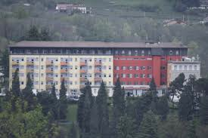
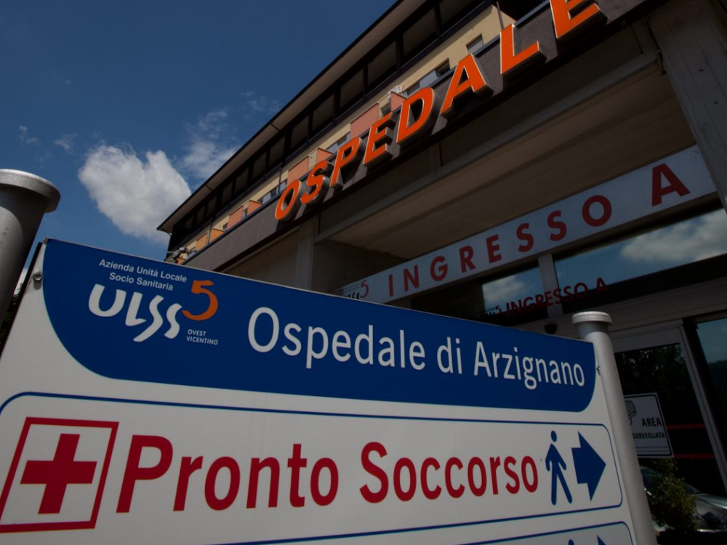
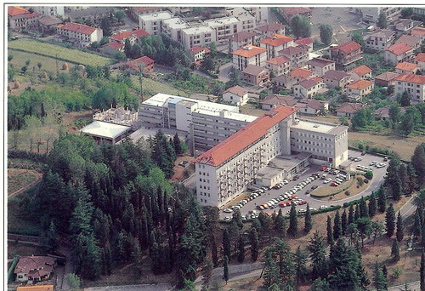
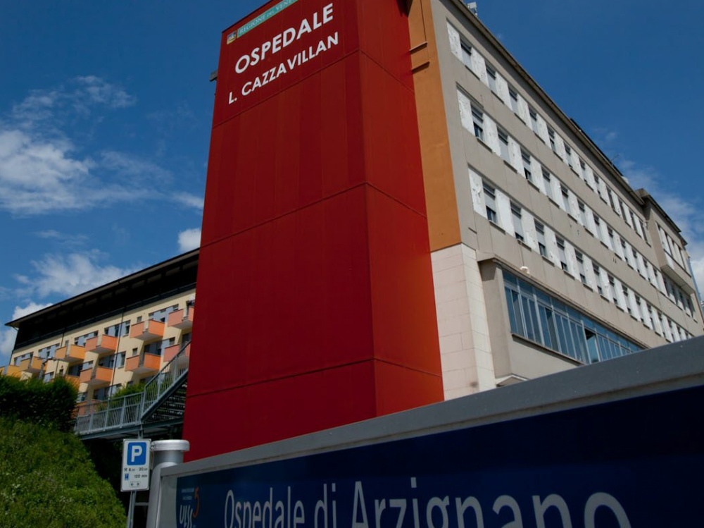

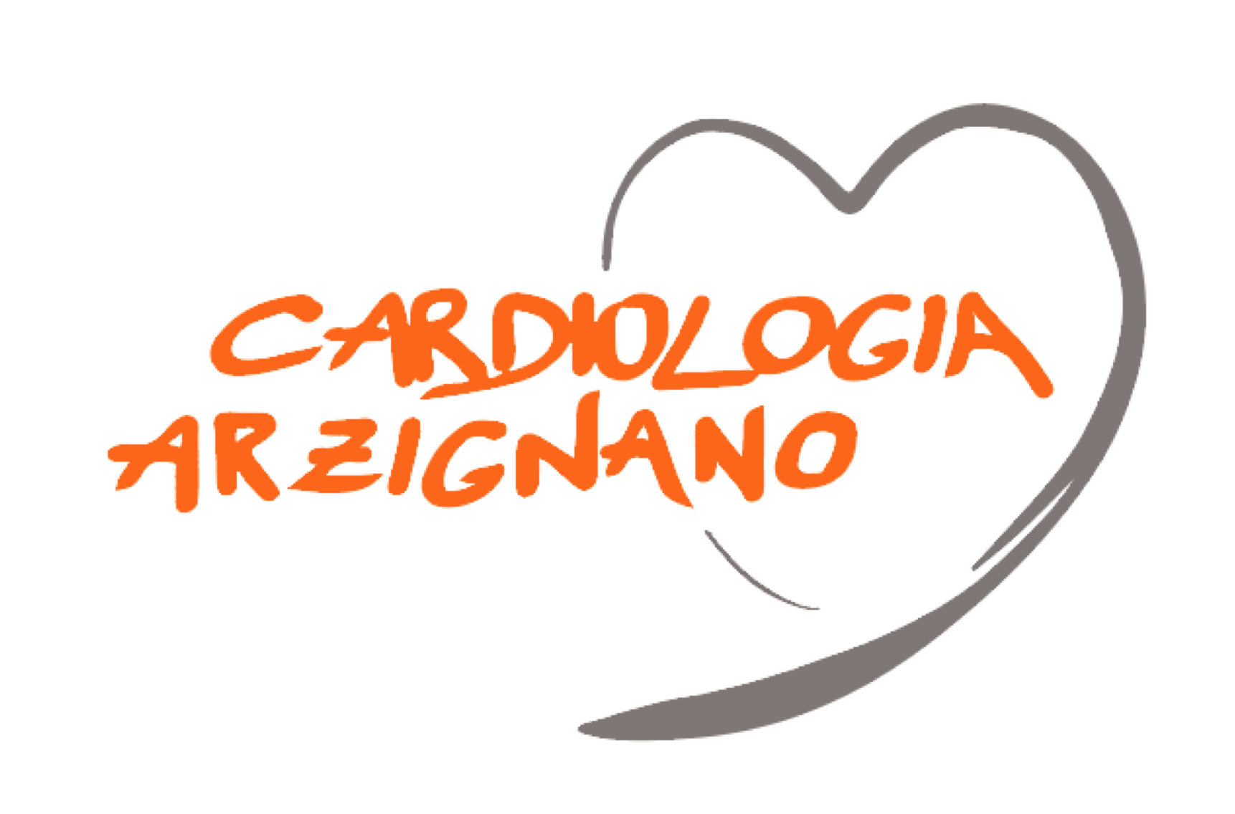
Obesità e malattie cardiovascolari:
fisiopatologia e evidenze
dalla letteratura
Claudio Bilato
Cardiologia, Ospedali dell’ Ovest Vicentino, ULSS 8 Berica
U n i t à O p e r a t i v a d i C a r d i o l o g i a - Ospedali dell’ Ovest Vicentino

Slide 2
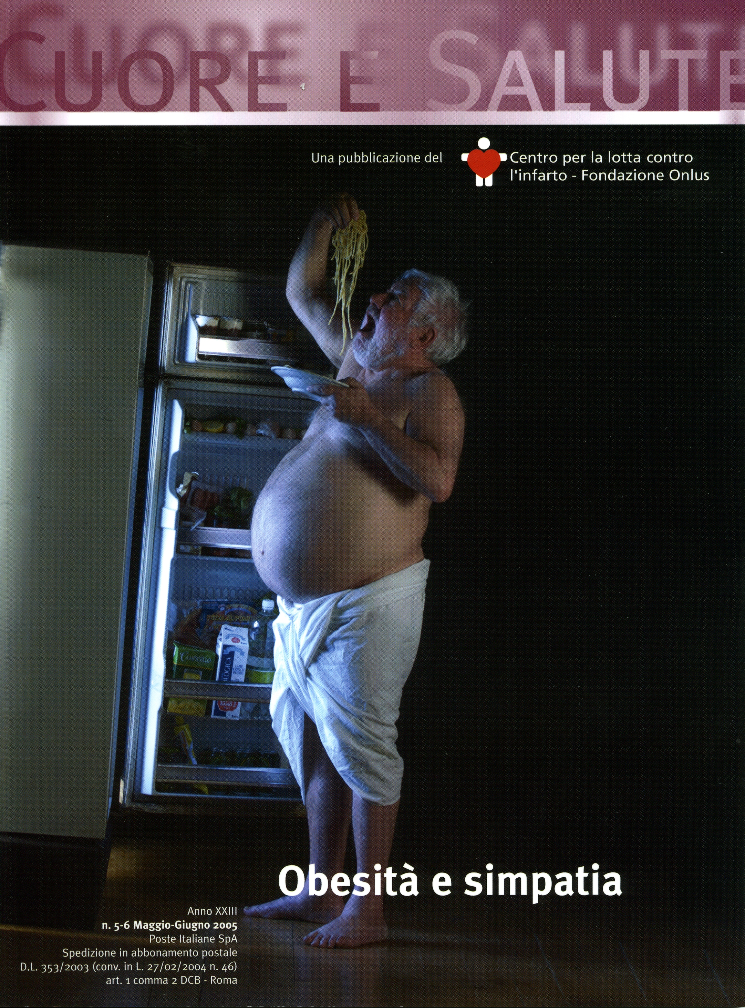
The pathophysiology of obesity in cardiovascular diseases is multifactorial, involving hemodynamic, metabolic, neurohormonal, and inflammatory mechanisms that collectively drive structural and functional changes in the heart and vasculature.
U n i t à O p e r a t i v a d i C a r d i o l o g i a - Ospedali dell’ Ovest Vicentino

Slide 3
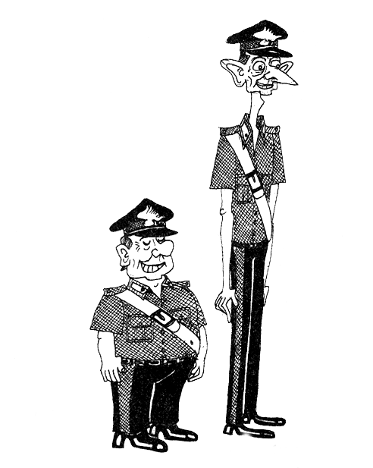
Why should cardiologists care about overweight and obesity?
U n i t à O p e r a t i v a d i C a r d i o l o g i a - Ospedali dell’ Ovest Vicentino

Slide 4
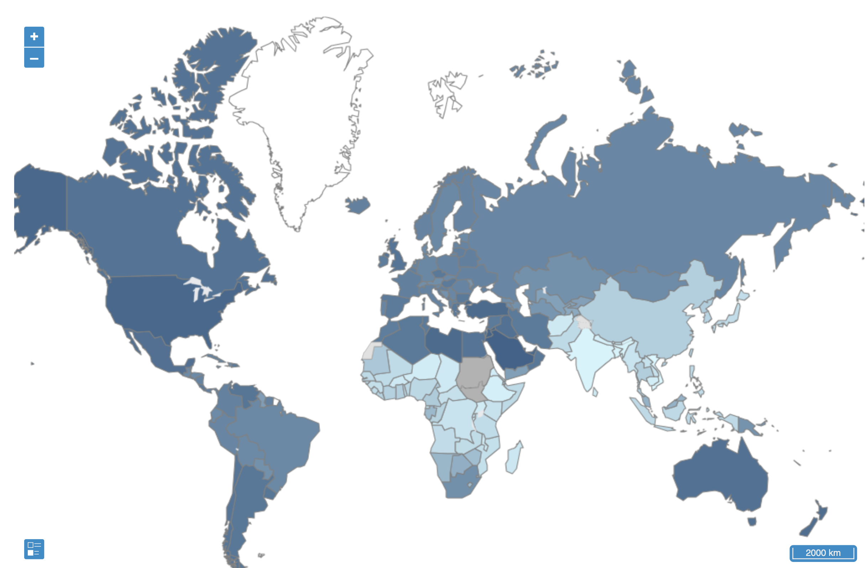
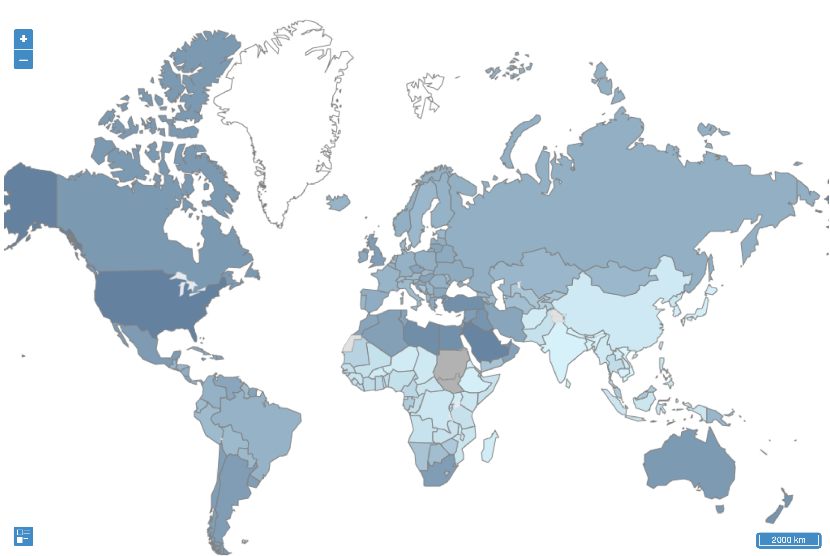


Prevalence* (%) of overweight (BMI > 25) adults , 2016
Prevalence* (%) of obese (BMI > 30) adults , 2016
Mean BMI in Italy
25.6 kg/m² [25.1-26.1]
*age-standardized estimate
88.5
18.3
No data
Data not available
Not applicable
61
2.1
No data
Data not available
Not applicable
Italy = 58.5 [54.2-62.5]
Italy = 19.9 [16.6-23.4]
Worldwide obesity has nearly tripled since 1975.
In 2016, more than 1.35 billion adults were overweight and 650 million were obese.
39% of adults were overweight in 2016, and 13% were obese.
39 million children under the age of 5 were overweight or obese in 2020.
Over 340 million children and adolescents aged 5-19 were overweight or obese in 2016.
World Health Organization. Obesity and overweight. June 9, 2021 (https://www.who.int/news-room/fact-sheets/detail/obesity -and-overweight).
U n i t à O p e r a t i v a d i C a r d i o l o g i a - Ospedali dell’ Ovest Vicentino

Slide 5
BMI (kg/m², mean ± SD) in 2 Italian populations with CHD
27.3 + 4.0
n = 4784
27.2 + 4.0
n = 1633
U n i t à O p e r a t i v a d i C a r d i o l o g i a - Ospedali dell’ Ovest Vicentino

Slide 6
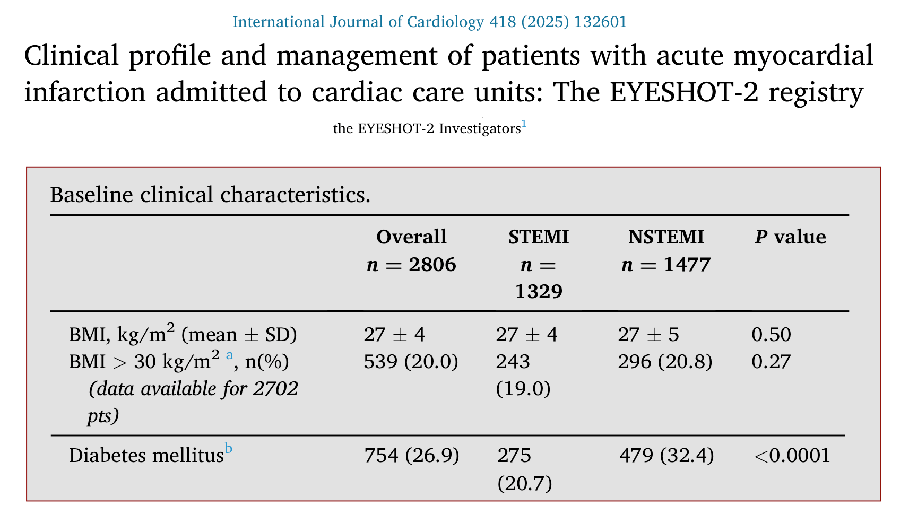
U n i t à O p e r a t i v a d i C a r d i o l o g i a - Ospedali dell’ Ovest Vicentino

Slide 7
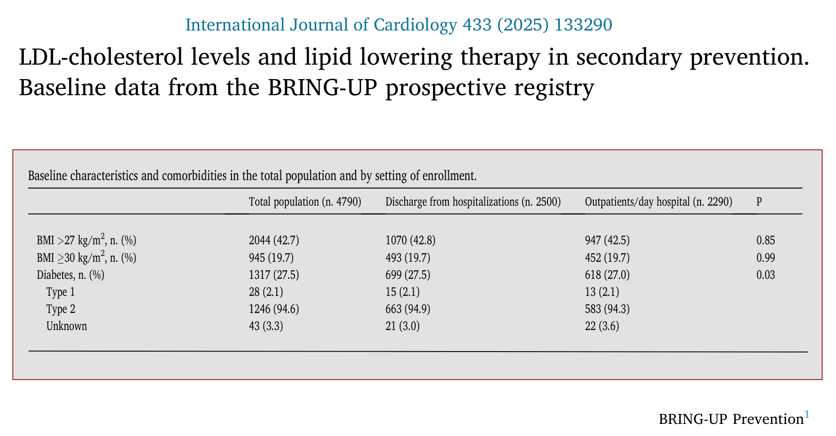
U n i t à O p e r a t i v a d i C a r d i o l o g i a - Ospedali dell’ Ovest Vicentino

Slide 8
Changes of some major cardiometabolic risk factors for heart failure-attributable mortality in Europe from 2012 to 2021
Estimates were determined using the World Health Organization non-communicable diseases dataset: from 2012 to 2021, 42 178 659 individuals (20 312 867 men and 21865792 women) died in the considered European countries. HF was listed as the primary cause of death in 4 872 634 (2 084 521 men and 2788113 women), equating to 11522 deaths 100000 population
U n i t à O p e r a t i v a d i C a r d i o l o g i a - Ospedali dell’ Ovest Vicentino

Slide 9
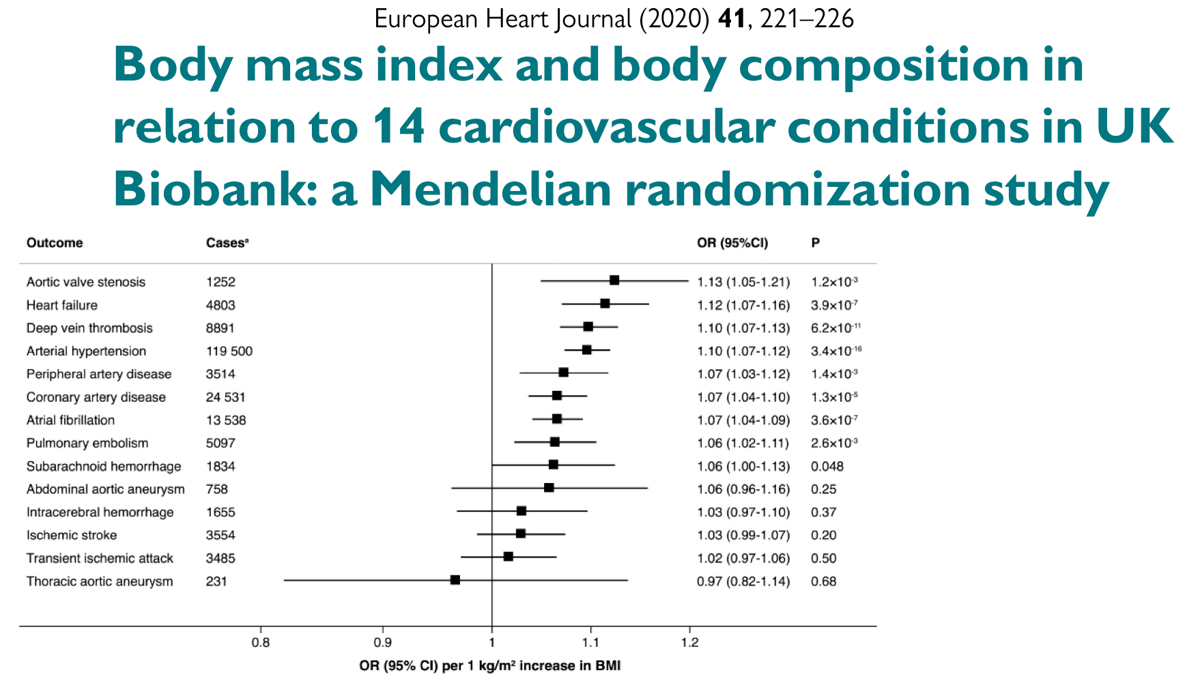
Associations of genetically predicted 1 kg/m² increase in BMI with 14 CV conditions in UK Biobank (n=367 703).
Single-nucleotide polymorphisms associated with BMI and fat mass and fat-free mass indices were used as instrumental variables to estimate the associations with CV conditions
After correcting for multiple testing, genetically predicted BMI was significantly positively associated with eight outcomes, including and with decreasing magnitude of association: aortic valve stenosis, heart failure, deep vein thrombosis, arterial hypertension, peripheral artery disease, coronary artery disease, atrial fibrillation, and pulmonary embolism.
U n i t à O p e r a t i v a d i C a r d i o l o g i a - Ospedali dell’ Ovest Vicentino

Slide 10
Health disorder attributable to connections among obesity, diabetes, CKD, and CVD, including HF, AF, CHD, stroke, and PAD
U n i t à O p e r a t i v a d i C a r d i o l o g i a - Ospedali dell’ Ovest Vicentino

Slide 11
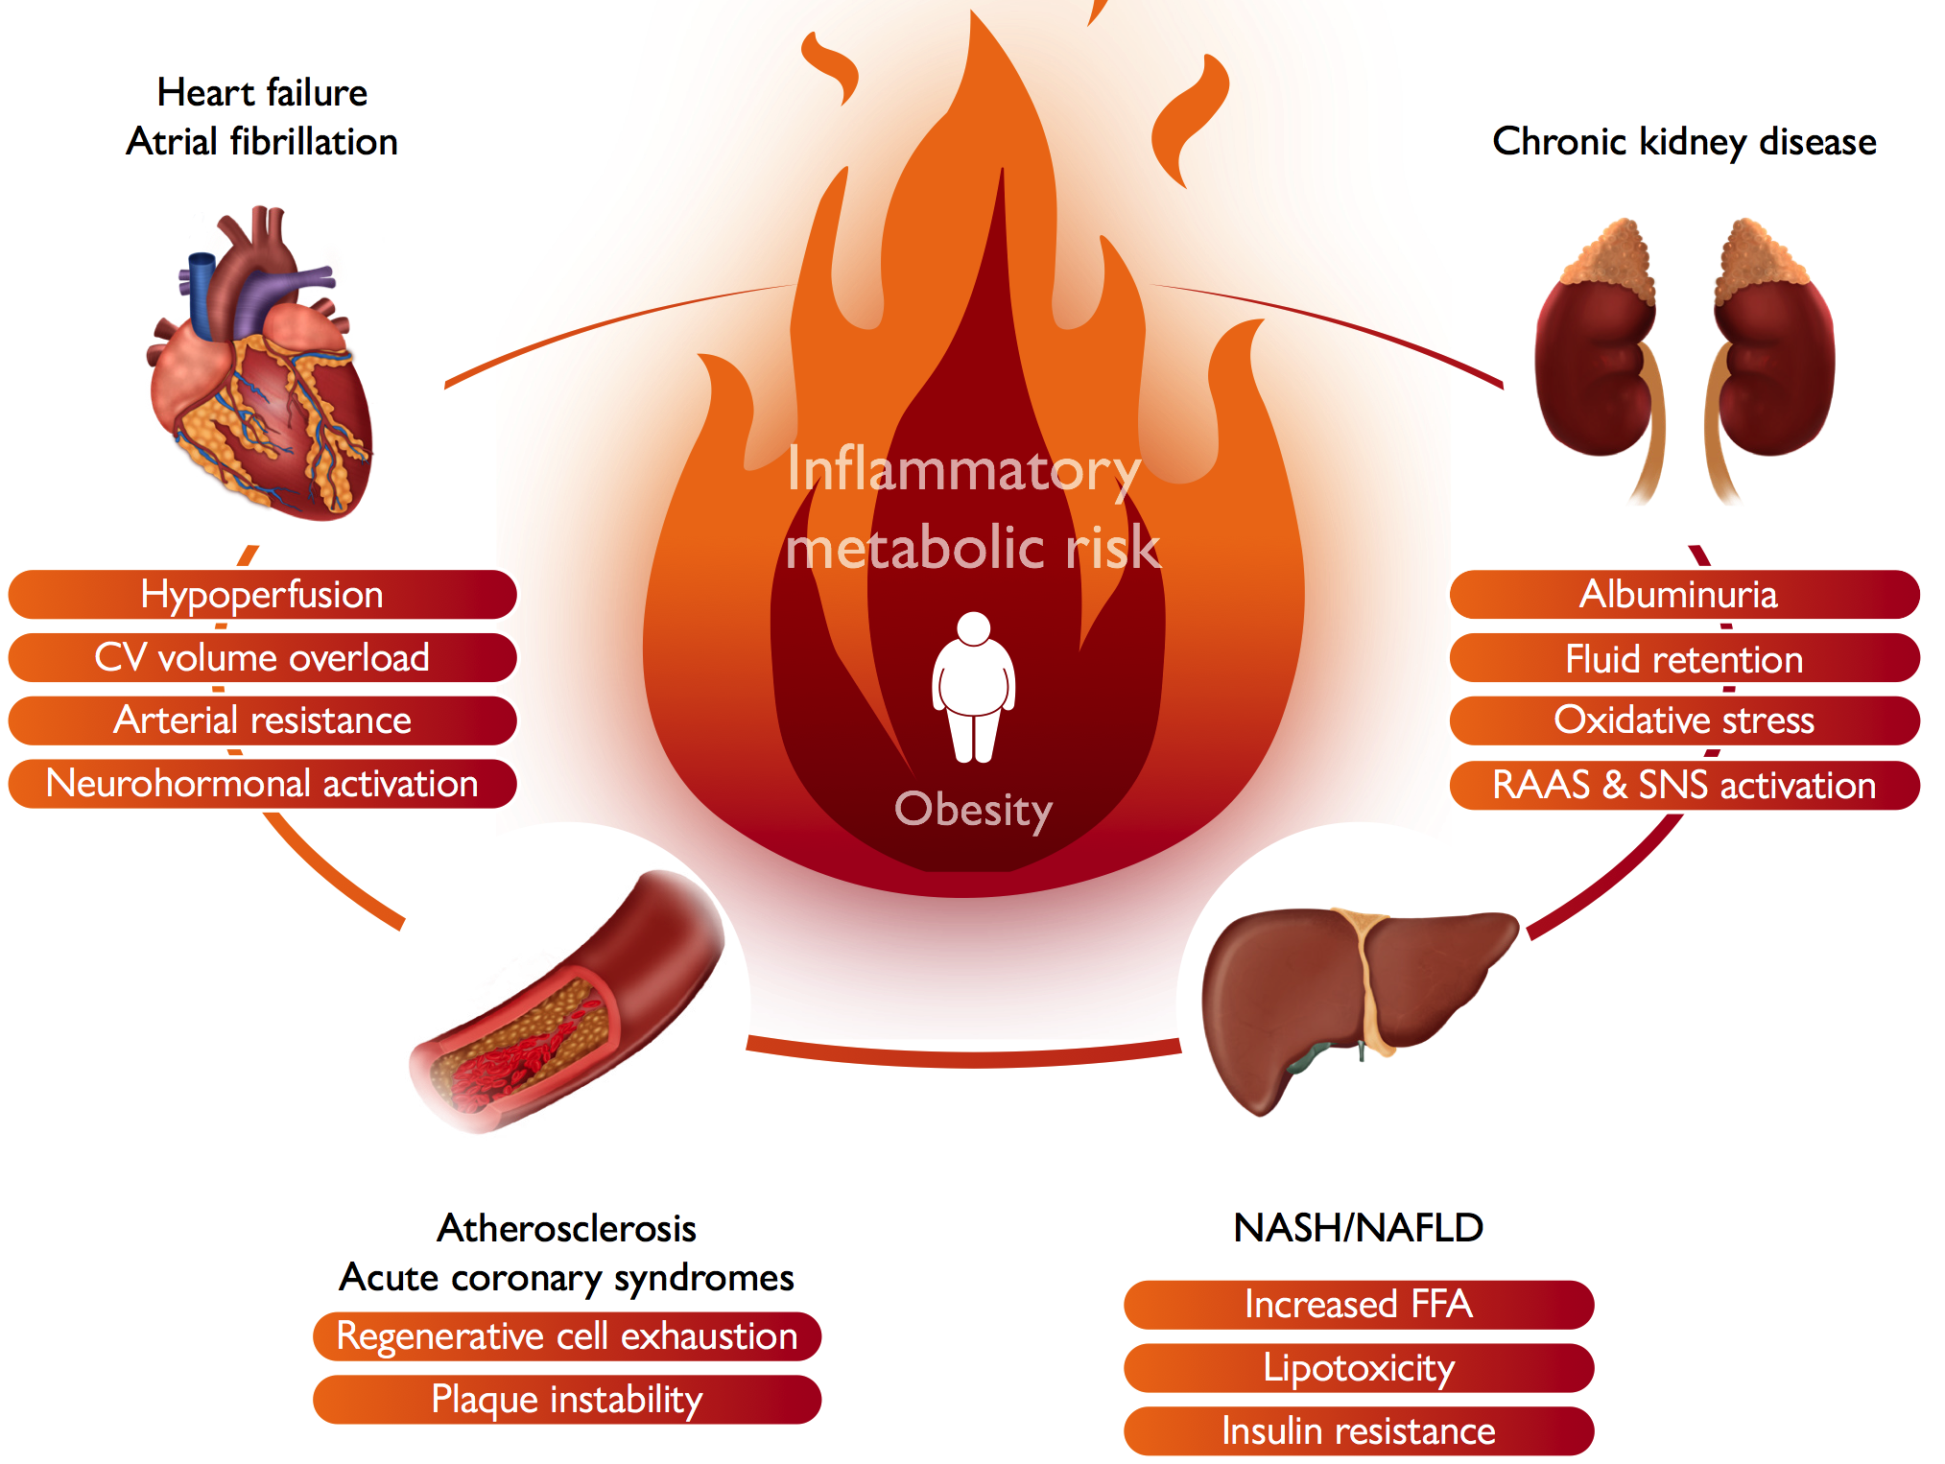
Obesity, particularly ectopic fat accumulation, has been linked to chronic inflammation and insulin resistance, which are linked to multiple pathways of cardiovascular risk
U n i t à O p e r a t i v a d i C a r d i o l o g i a - Ospedali dell’ Ovest Vicentino

Slide 12
Positive energy balance
(nutrition and exercize)
Sick fat Disease
(dysfunctional adipose tissue)
Fat mass Disease
(biomechanical abnormalities)
Genetics
Environment
Atherosclerosis
Heart failure
Arrhythmyas
U n i t à O p e r a t i v a d i C a r d i o l o g i a - Ospedali dell’ Ovest Vicentino

Slide 13
Mechanisms driving the development of atherosclerosis in insulin resistent patients
U n i t à O p e r a t i v a d i C a r d i o l o g i a - Ospedali dell’ Ovest Vicentino

Slide 14
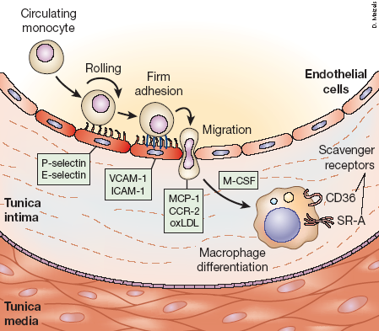
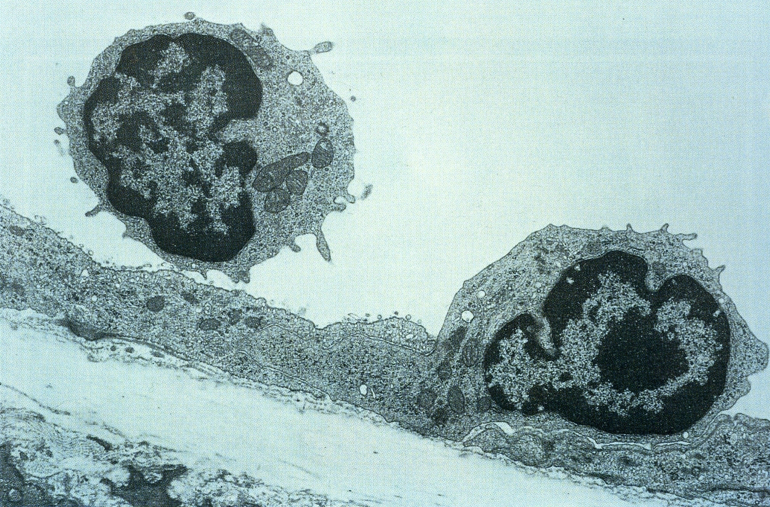
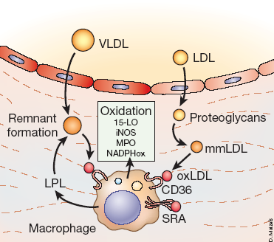
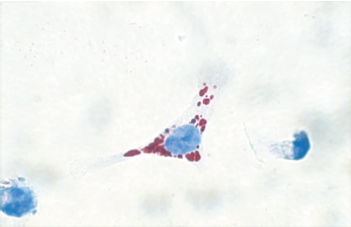
Excess weight promotes atherosclerosis
Blood pressure
Serum glucose
BMI
Insulin resistance
Risk factors contribute to:
Plasma lipids
Inflammation
U n i t à O p e r a t i v a d i C a r d i o l o g i a - Ospedali dell’ Ovest Vicentino

Slide 15
U n i t à O p e r a t i v a d i C a r d i o l o g i a - Ospedali dell’ Ovest Vicentino

Slide 16
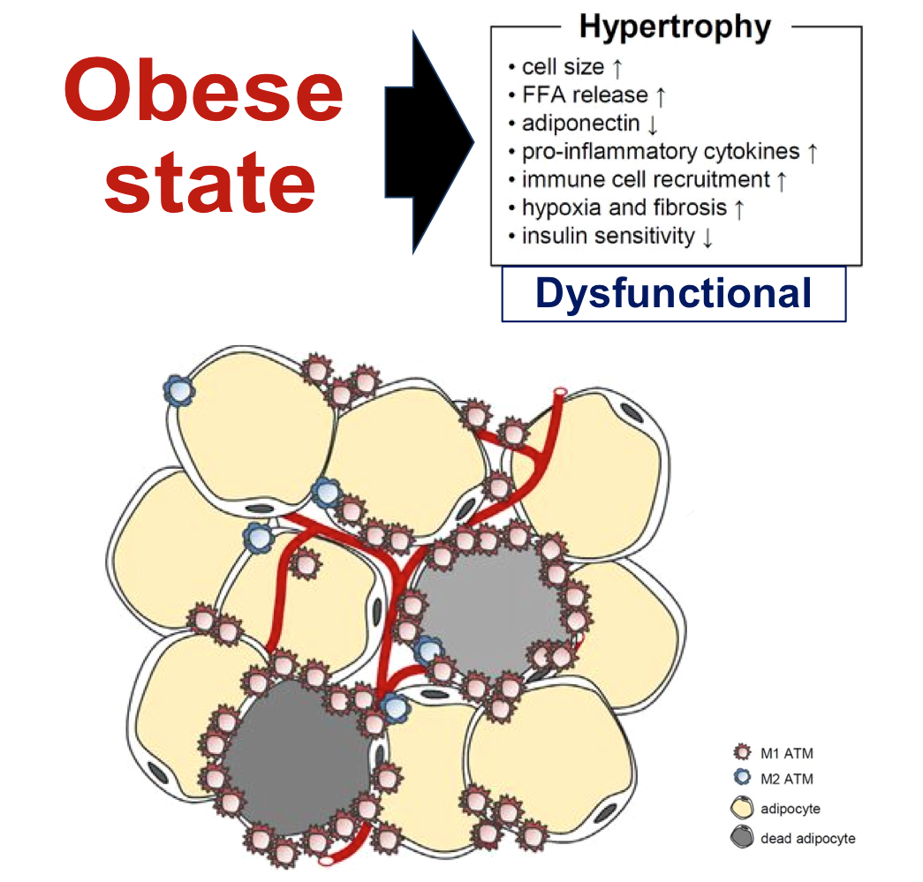
Five different signaling pathways are dominant determinants of adipose tissue inflammation: increased circulating endotoxin due to dysregulation in the microbiota-gut-brain axis, systemic oxidative stress, macrophage accumulation, adipocyte death and NLRP3 inflammasome activation
Release of several highly active molecules (adipokines) (leptin, resistin, adiponectin, visfatin) and classical cytokines, such as TNFα, IL-6, MCP-1 and IL-1.
Three metabolic pathways are noteworthy in the development of adipose tissue inflammation: toll-like receptor 4/ phosphatidyl-inositol-3′-kinase/Protein kinase B signaling pathway, endoplasmic reticulum stress-derived unfolded protein response, and inhibitor of nuclear factor kappa-B kinase beta (IKKβ)- nuclear factor kappa B (NF-κB) pathway
U n i t à O p e r a t i v a d i C a r d i o l o g i a - Ospedali dell’ Ovest Vicentino

Slide 17
monocytes adhesion to “activated” endothelial cells
cholesterol crystal-induced activation of NLRP3 inflammasome in foam cells
U n i t à O p e r a t i v a d i C a r d i o l o g i a - Ospedali dell’ Ovest Vicentino

Slide 18
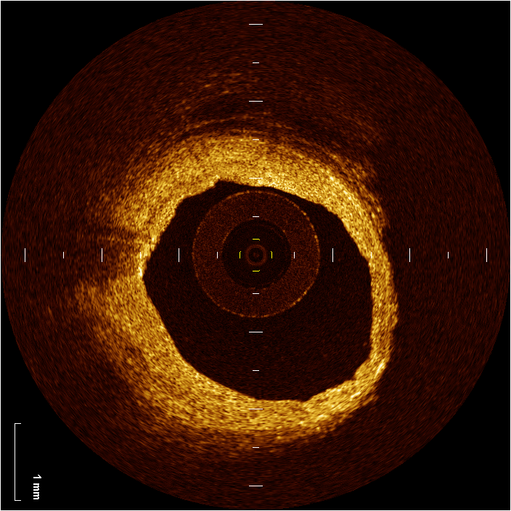
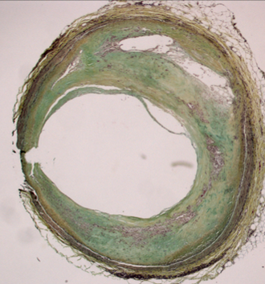
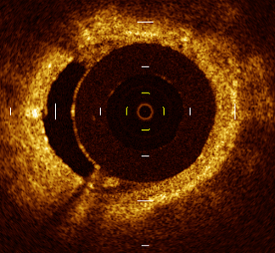
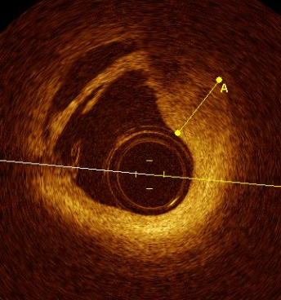
Atheromas at early stages
Fatty streaks
Cluster of foam cells
Lipid pool
U n i t à O p e r a t i v a d i C a r d i o l o g i a - Ospedali dell’ Ovest Vicentino

Slide 19
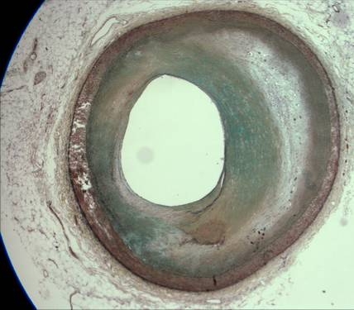
Stable plaque
Vulnerable plaque
L
L
F
F
Vulnerability features: thin fibrous cap (<65 μm), a necrotic core more than 30% of the total plaque, haemorrhage, infiltration of inflammatory cells, low VSMC density
U n i t à O p e r a t i v a d i C a r d i o l o g i a - Ospedali dell’ Ovest Vicentino

Slide 20
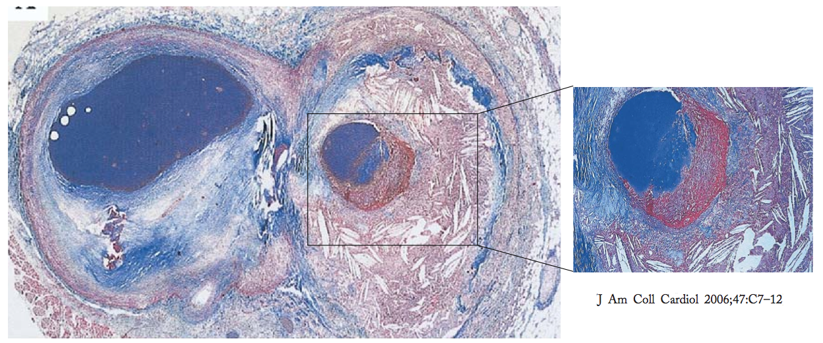
Towards stability (healing)
or towards clinical event?
U n i t à O p e r a t i v a d i C a r d i o l o g i a - Ospedali dell’ Ovest Vicentino

Slide 21
Towards stability (healing)
or towards clinical event?
U n i t à O p e r a t i v a d i C a r d i o l o g i a - Ospedali dell’ Ovest Vicentino

Slide 22

U n i t à O p e r a t i v a d i C a r d i o l o g i a - Ospedali dell’ Ovest Vicentino

Slide 23

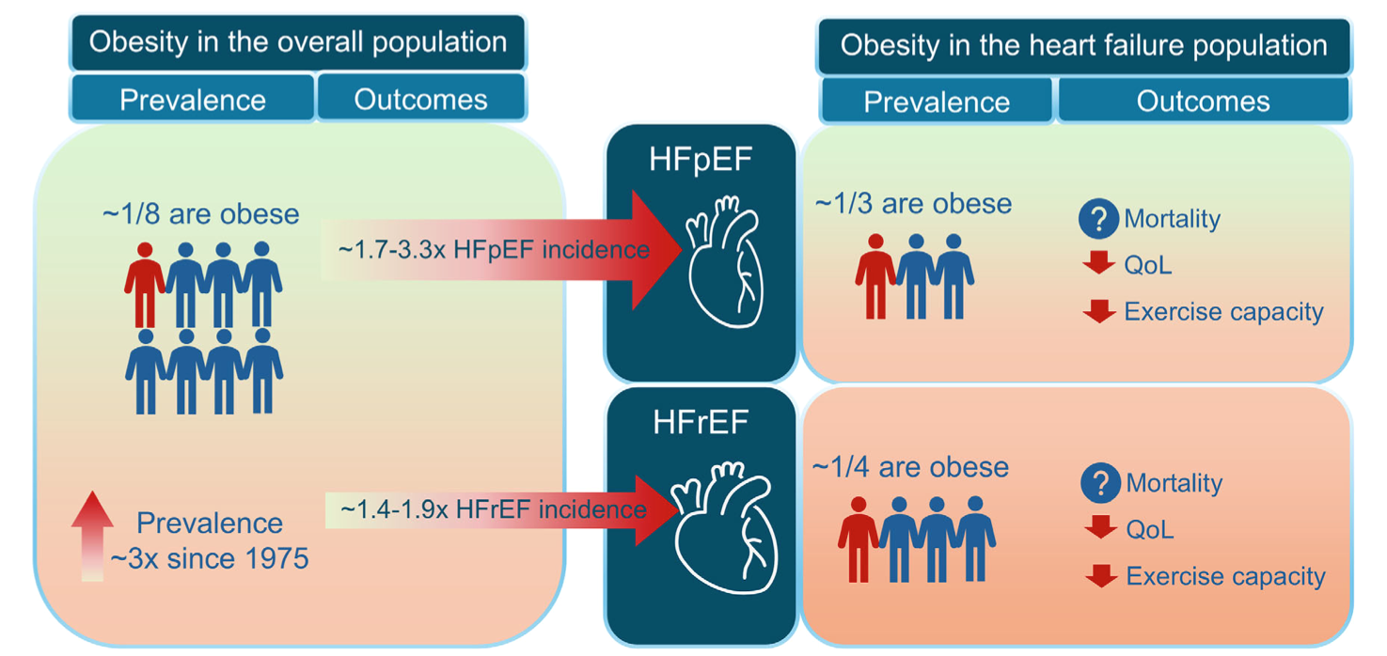
Obesity prevalence in the overall population, and risk of and complications in HFrEF and HFpEF
U n i t à O p e r a t i v a d i C a r d i o l o g i a - Ospedali dell’ Ovest Vicentino

Slide 24
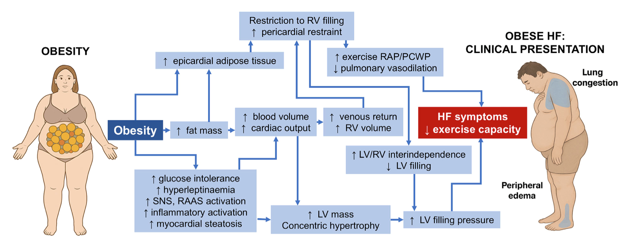
Pathophysiological link between obesity and heart failure
U n i t à O p e r a t i v a d i C a r d i o l o g i a - Ospedali dell’ Ovest Vicentino

Slide 25
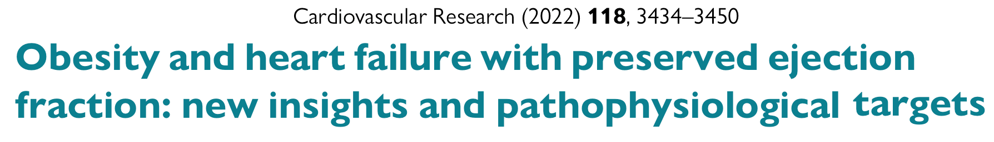
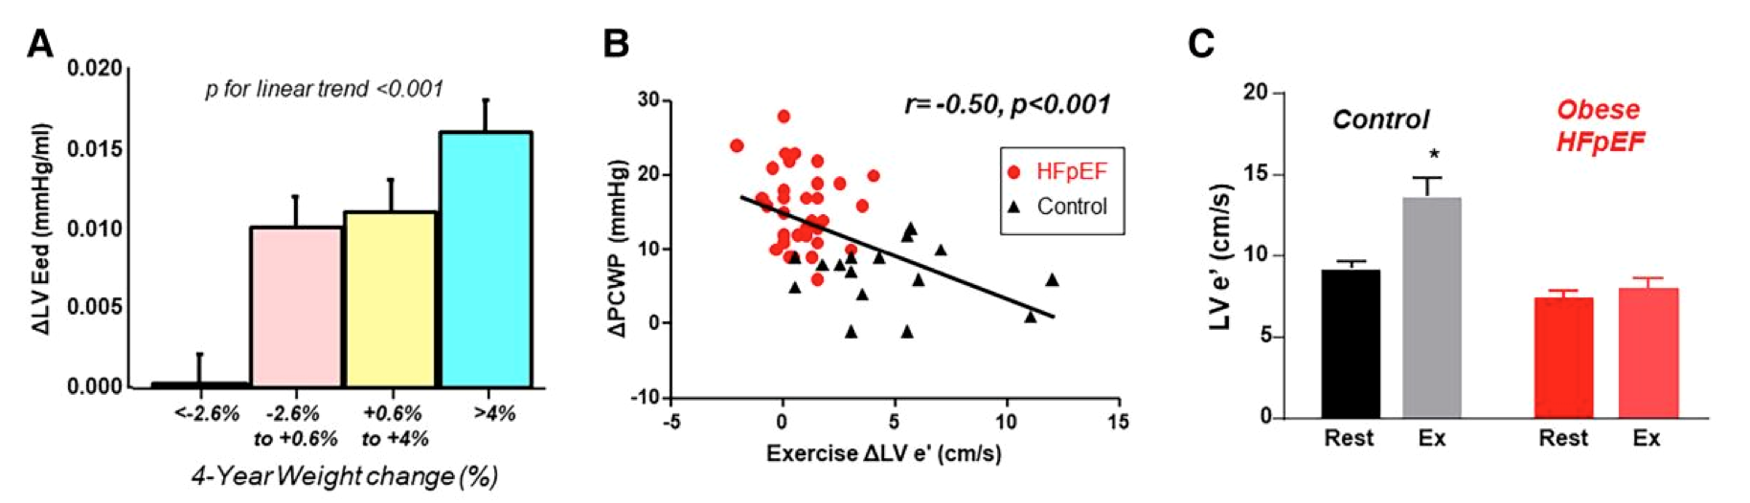
(A) Increasing weight gain is associated with progressively greater increases in estimated LV end diastolic chamber stiffness (ΔLV Eed) over time in community-dwelling adults, predisposing to HFpEF. (B) Impairments in the ability to enhance LV early diastolic relaxation velocity (ΔLV e′) with exercise are associated with greater increases in pulmonary capillary wedge pressure (PCWP), and enhancement in LV e′ with exercise is substantially blunted in obese HFpEF (C )
U n i t à O p e r a t i v a d i C a r d i o l o g i a - Ospedali dell’ Ovest Vicentino

Slide 26
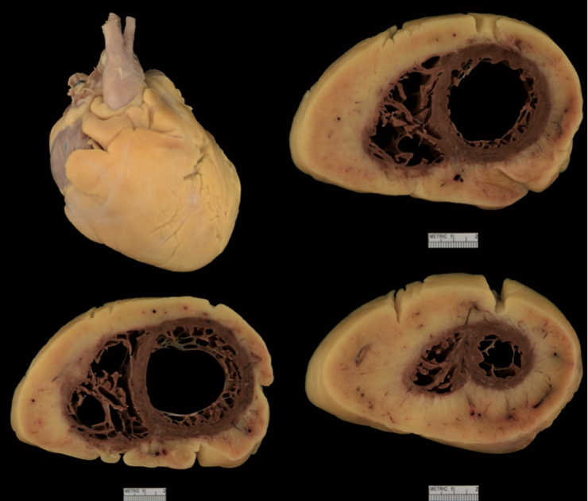
An 82-year-old woman with HFpEF, recurrent hospitalizations (in the last 12 months), obesity, AF, diabetes, and CKD presented with worsening dyspnoea and oedema.
LVEF 57%, normal LV mass, mild left atrial enlargement, a dilated inferior vena cava, and PAPS of 48 mmHg.
Parenteral diuretics and antibiotics were administered, but symptoms worsened and died 4 days later.
At autopsy, total heart weight upon removal from the chest was 758 g, with marked circumferential epicardial fat deposition.
Following dissection of epicardial fat, the heart weighed 415g (expected weight 241g). Thus, epicardial fat accounted for 343 g, 46%of the total heart mass.
Cause of death was established as sepsis complicated by congestive heart failure.
U n i t à O p e r a t i v a d i C a r d i o l o g i a - Ospedali dell’ Ovest Vicentino

Slide 27
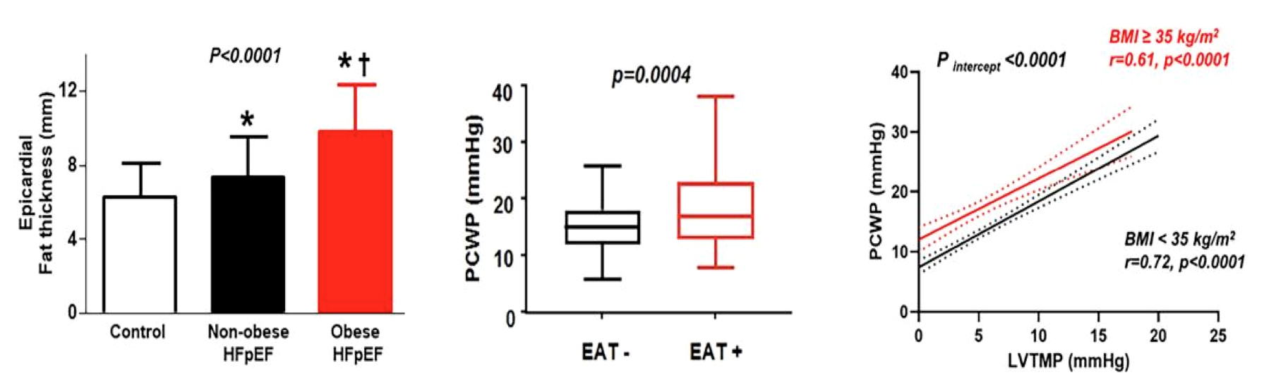
When compared with healthy controls and non-obese HFpEF, patients with obese HFpEF display increased epicardial fat thickness, which is associated with higher pulmonary capillary wedge pressures (PCWP). The increase in external constraint on the heart in patients with obesity results in a higher PCWP for any LV transmural distending pressure (LVTMP).
U n i t à O p e r a t i v a d i C a r d i o l o g i a - Ospedali dell’ Ovest Vicentino

Slide 28
U n i t à O p e r a t i v a d i C a r d i o l o g i a - Ospedali dell’ Ovest Vicentino

Slide 29
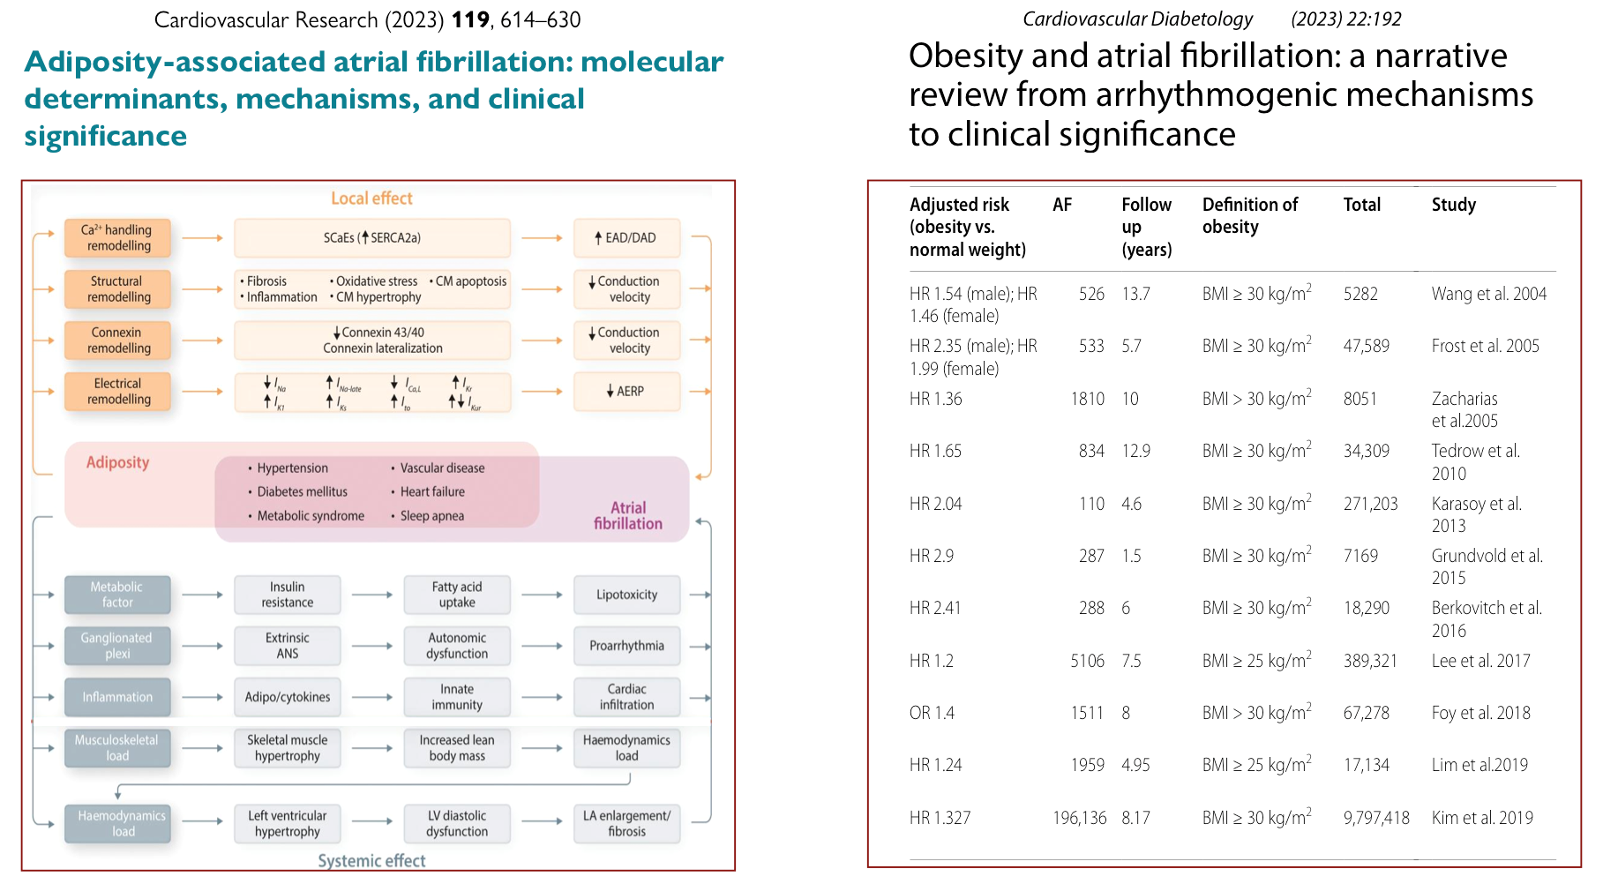
U n i t à O p e r a t i v a d i C a r d i o l o g i a - Ospedali dell’ Ovest Vicentino

Slide 30
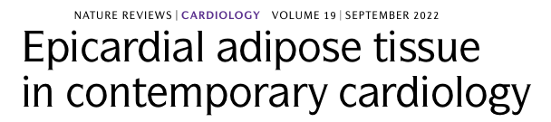
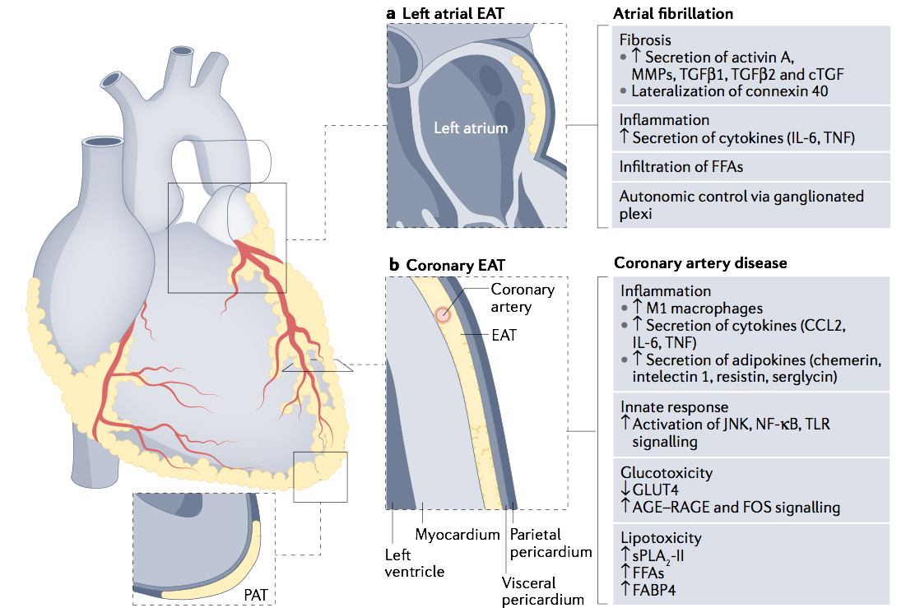
Epicardial adipose tissue (EAT) has anatomical and functional interactions with the heart owing to shared circulation and absence of muscle fascia separating the two organs.
Regional distribution of EAT is important because pericoronary EAT and left atrial EAT differently affect the risk of CAD and atrial fibrillation, respectively.
EAT has a role in the development of several cardiovascular diseases through complex mechanisms, including gene expression profile, pro-inflammatory and profibrotic proteome, neuromodulation, and glucose and lipid metabolism.
U n i t à O p e r a t i v a d i C a r d i o l o g i a - Ospedali dell’ Ovest Vicentino

Slide 31
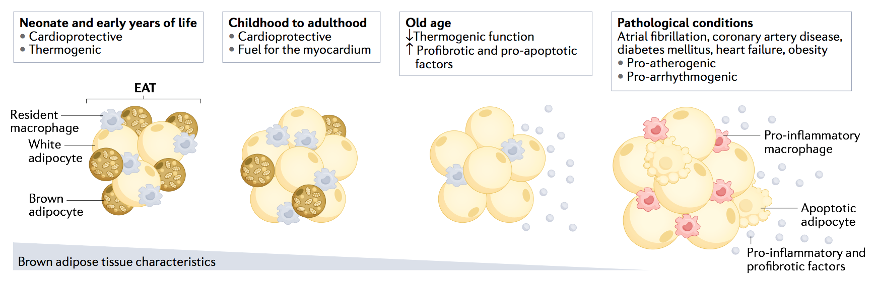
EAT changes with age and in pathological conditions. In the neonate and early years of life, EAT is morphologically and functionally similar to brown adipose tissue. The brown fat-like properties of EAT rapidly decrease with age, from childhood to adulthood. However, EAT maintains cardioprotective functions such as providing a source of energy and heat to the heart. In pathological conditions, such as CAD, DM, HF and AF, EAT becomes pro-atherogenic and pro-arrhythmogenic.
U n i t à O p e r a t i v a d i C a r d i o l o g i a - Ospedali dell’ Ovest Vicentino

Slide 32
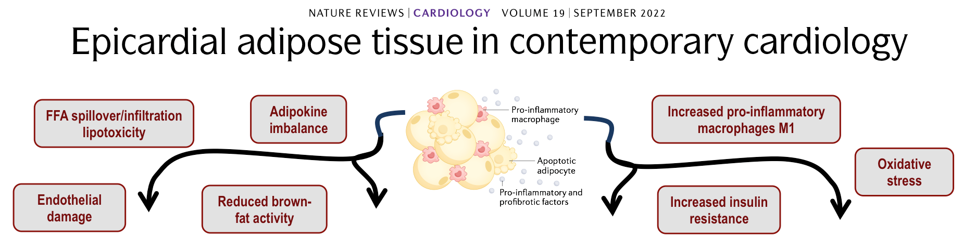
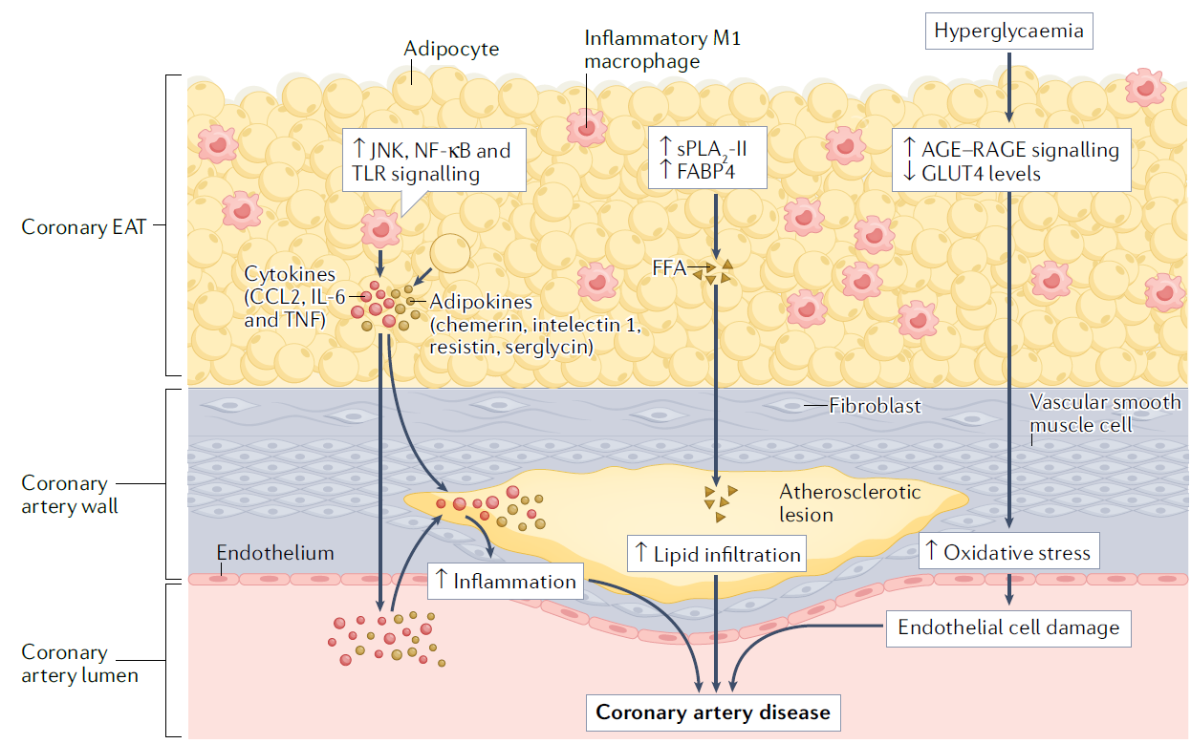
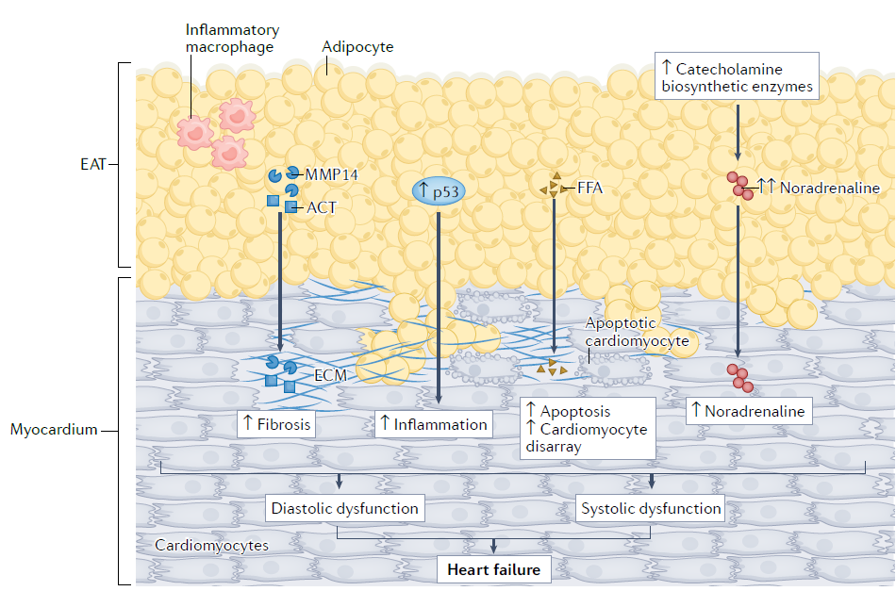
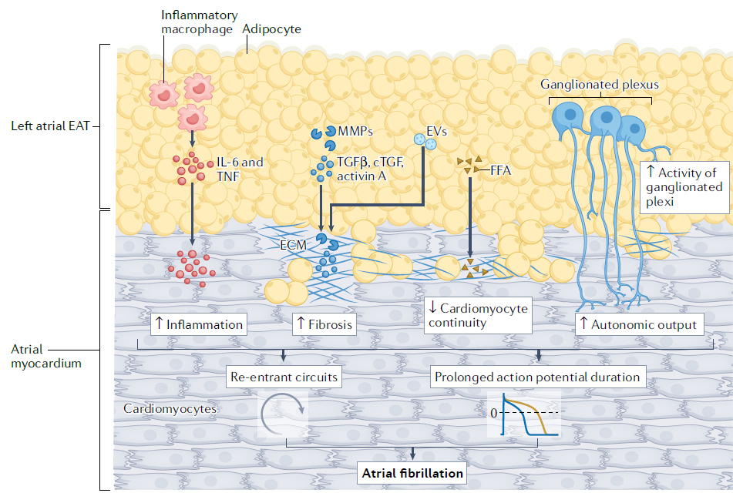
Atherosclerosis
Heart failure
Arrhythmyas
U n i t à O p e r a t i v a d i C a r d i o l o g i a - Ospedali dell’ Ovest Vicentino

Slide 33
HR 1.16; 95% CI 1.03 to 1.31; P=0.02)
U n i t à O p e r a t i v a d i C a r d i o l o g i a - Ospedali dell’ Ovest Vicentino

Slide 34
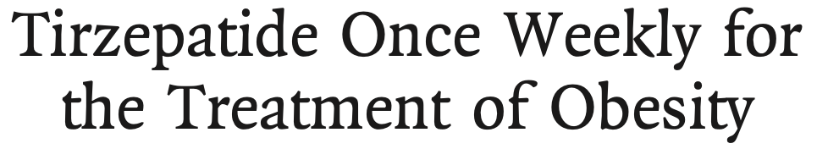
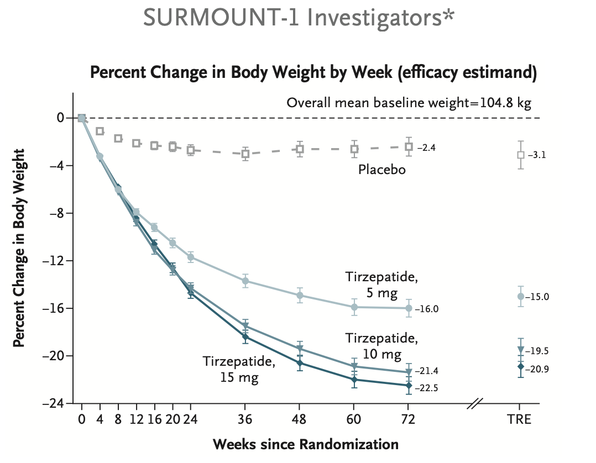
Double-blind trial, enrolling 1961 adults with a BMI > 30 or greater (≥27 if ≥1 weight-related coexisting condition), and no diabetes, randomly assigned, in a 2:1 ratio, to 68 weeks of once-weekly subcutaneous semaglutide (2.4 mg) or placebo, plus lifestyle intervention.
Coprimary end points were % change in body weight and weight reduction >5%.
The mean change in body weight from baseline to week 68 was −14.9% in the semaglutide group as compared with −2.4% with placebo
phase 3 double-blind, randomized, controlled trial, enrolling 2539 adults with BMI > 30 (> 27 and if > 1weight-related complication) and no diabetes, in a 1:1:1:1 ratio to receive once-weekly, subcutaneous tirzepatide (5, 10 or 15 mg) or placebo for 72 weeks, including a 20-week dose-escalation period.
Coprimary end points were % change in weight and a weight > 5%
U n i t à O p e r a t i v a d i C a r d i o l o g i a - Ospedali dell’ Ovest Vicentino

Slide 35
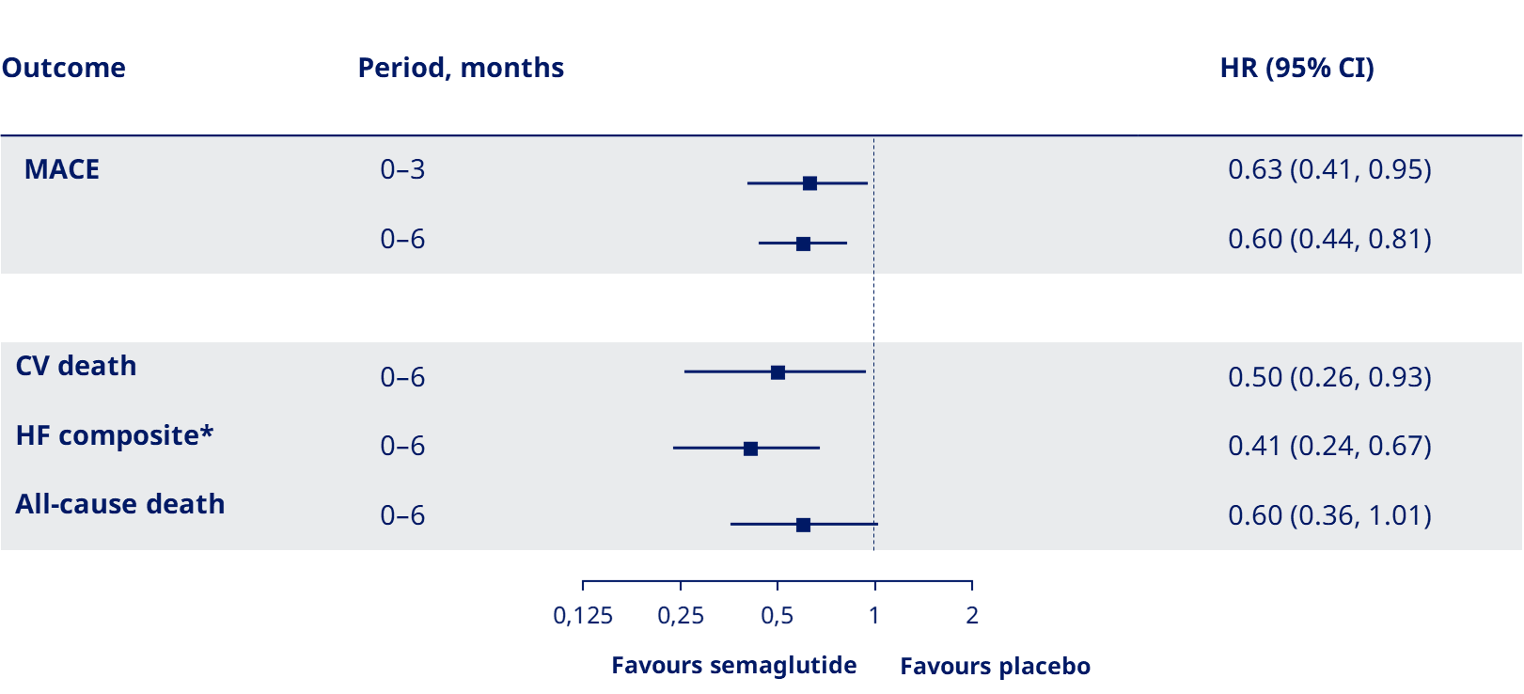
Multicenter, double-blind, randomized, placebo-controlled, event-driven superiority trial on 17,604 patients > 45 years , with CVDs and BMI > 27 but no diabetes, randomly assigned (1:1) to 2.4 mg s.c. semaglutide once-weekly or placebo.
Primary end point was a composite of death from CV causes, nonfatal MI or stroke in a time-to-first-event. Mean (SD) duration of exposure to semaglutide or placebo was 34.2±13.7 mo., and mean duration of follow-up was 39.8±9.4 mo.
At the planned trial visits, the treatment difference (semaglutide - placebo) in mean body weight was −1.1% (95% CI −1.2, −1.1) at week 4 and −3.6% (95% CI −3.7, 3.5) at week 12.
Presented on November 10th, 2023 AHA sessions
U n i t à O p e r a t i v a d i C a r d i o l o g i a - Ospedali dell’ Ovest Vicentino

Slide 36

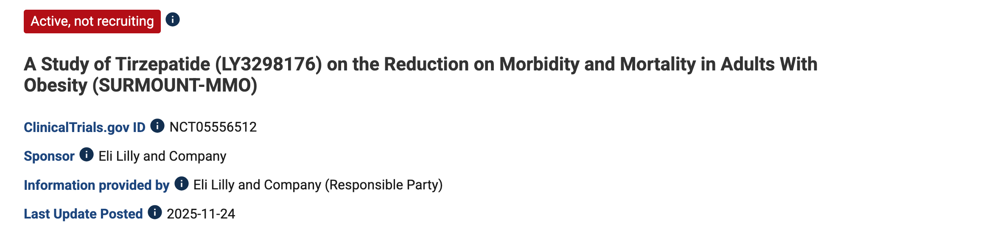
U n i t à O p e r a t i v a d i C a r d i o l o g i a - Ospedali dell’ Ovest Vicentino

Slide 37
Grazie 1000!!!
claudio.bilato@aulss8.veneto.it
U n i t à O p e r a t i v a d i C a r d i o l o g i a - Ospedali dell’ Ovest Vicentino

